Slide 1
DIGITAL PORTFOLIO
STUDENT NAME: SANJAY KUMAR.M
REGISTER NO AND NMID: 2422K1955/asbru062422k1955
DEPARTMENT: B SC COMPUTER SCIENCE
COLLEGE: CHIKKANNA GOVERNMENT ARTS AND SCIENCE
UNIVERSITY: BHARATHIYAR UNIVERCITY
1
Notes:
1

Slide 2
PROJECT TITLE
PHOTO SHOPPING
AND
VIDEO EDITING
2

Slide 3
AGENDA
Problem Statement
Project Overview
End Users
Tools and Technologies
Portfolio design and Layout
Features and Functionality
Results and Screenshots
Conclusion
Github Link
3

Slide 4

PROBLEM STATEMENT
CREATING A PROFESSIONAL PORTFOLIO TO SHOWCASE CREATIVE SKILLS, PROJECTS, AND CONTACT DETAILS IN AN ATTRACTIVE UI.
4

Slide 5

PROJECT OVERVIEW
A PERSONAL PORTFOLIO WEBSITE BUILT USING HTML, CSS, AND DICEBEAR AVATARS WITH MUSTARD YELLOW THEME.
5

Slide 6
WHO ARE THE END USERS?
STUDENTS, RECRUITERS, PROFESSIONALS, CLIENTS WHO WANT TO EXPLORE PROFILE AND WORKS.
6

Slide 7
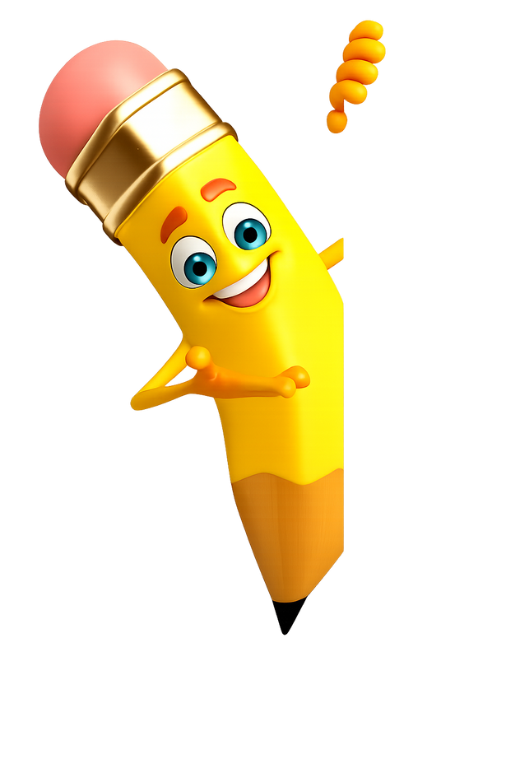
TOOLS AND TECHNIQUES
TOOLS:The tools I have used in this digital portfolio is
HTML5, CSS, javascript, FIRE FOX and codepen for code
editor.
TECHNIQUES:I used semantic tags like <nav>
,
<head>
,
<footer> for better readability. I used external CSS for
adding styles to my portfolio. I used to also
javascript for smooth navigation.
HTML, CSS, Dicebear API for avatars, Responsive Web Design.
7

Slide 8
POTFOLIO DESIGN AND LAYOUT
• MUSTARD YELLOW GRADIENT THEME
• GLASSMORPHISM CONTAINER
• STICKY NAVIGATION BAR
• PROFILE PHOTO OPTIONS
8

Slide 9
FEATURES AND FUNCTIONALITY
• SKILLS SHOWCASE
• PROJECTS GRID WITH ADD OPTION
• CONTACT DETAILS SECTION
• ANIMATED HOVER EFFECTS
• MODAL FOR PROFILE IMAGE

Slide 10
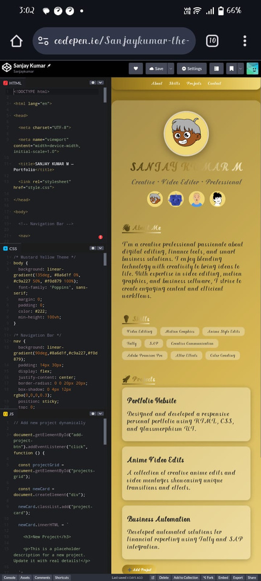
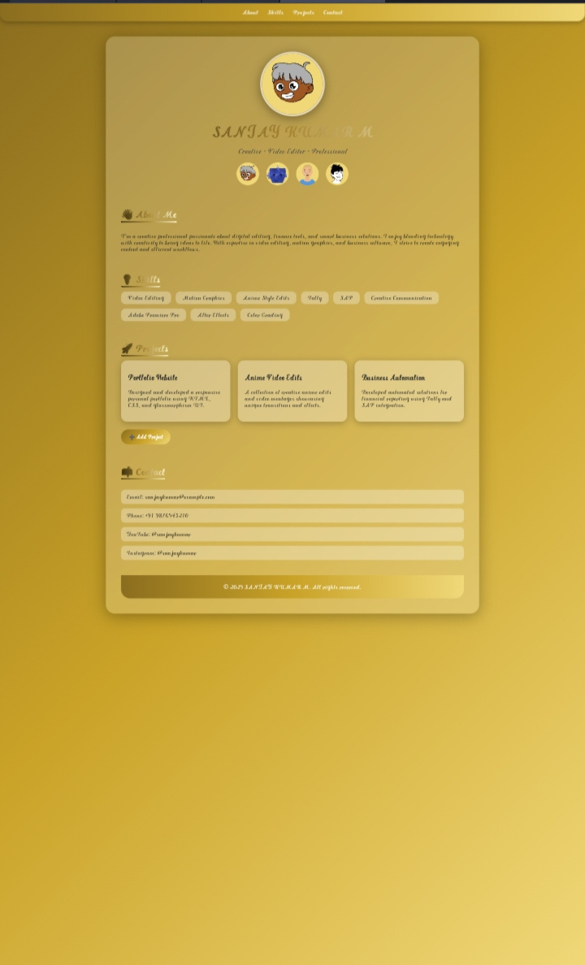
RESULTS AND SCREENSHOTS

Slide 11
CONCLUSION
THE PORTFOLIO HELPS PRESENT PROFESSIONAL AND CREATIVE IDENTITY EFFECTIVELY ONLINE.
11

Slide 12
THANK YOU
CREATED
BY
SANJAYKUMAR.M
11

